Slide 1
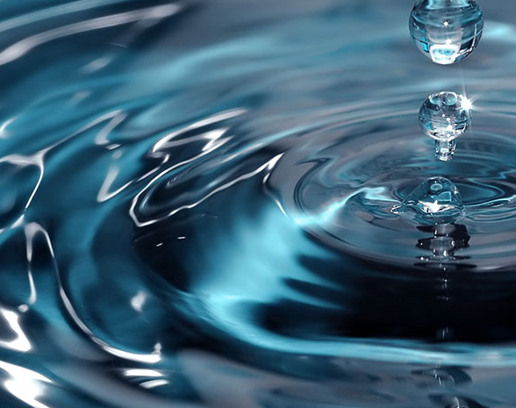
Water Filtration System

Slide 2
Task 1
Water Filtration

Slide 3
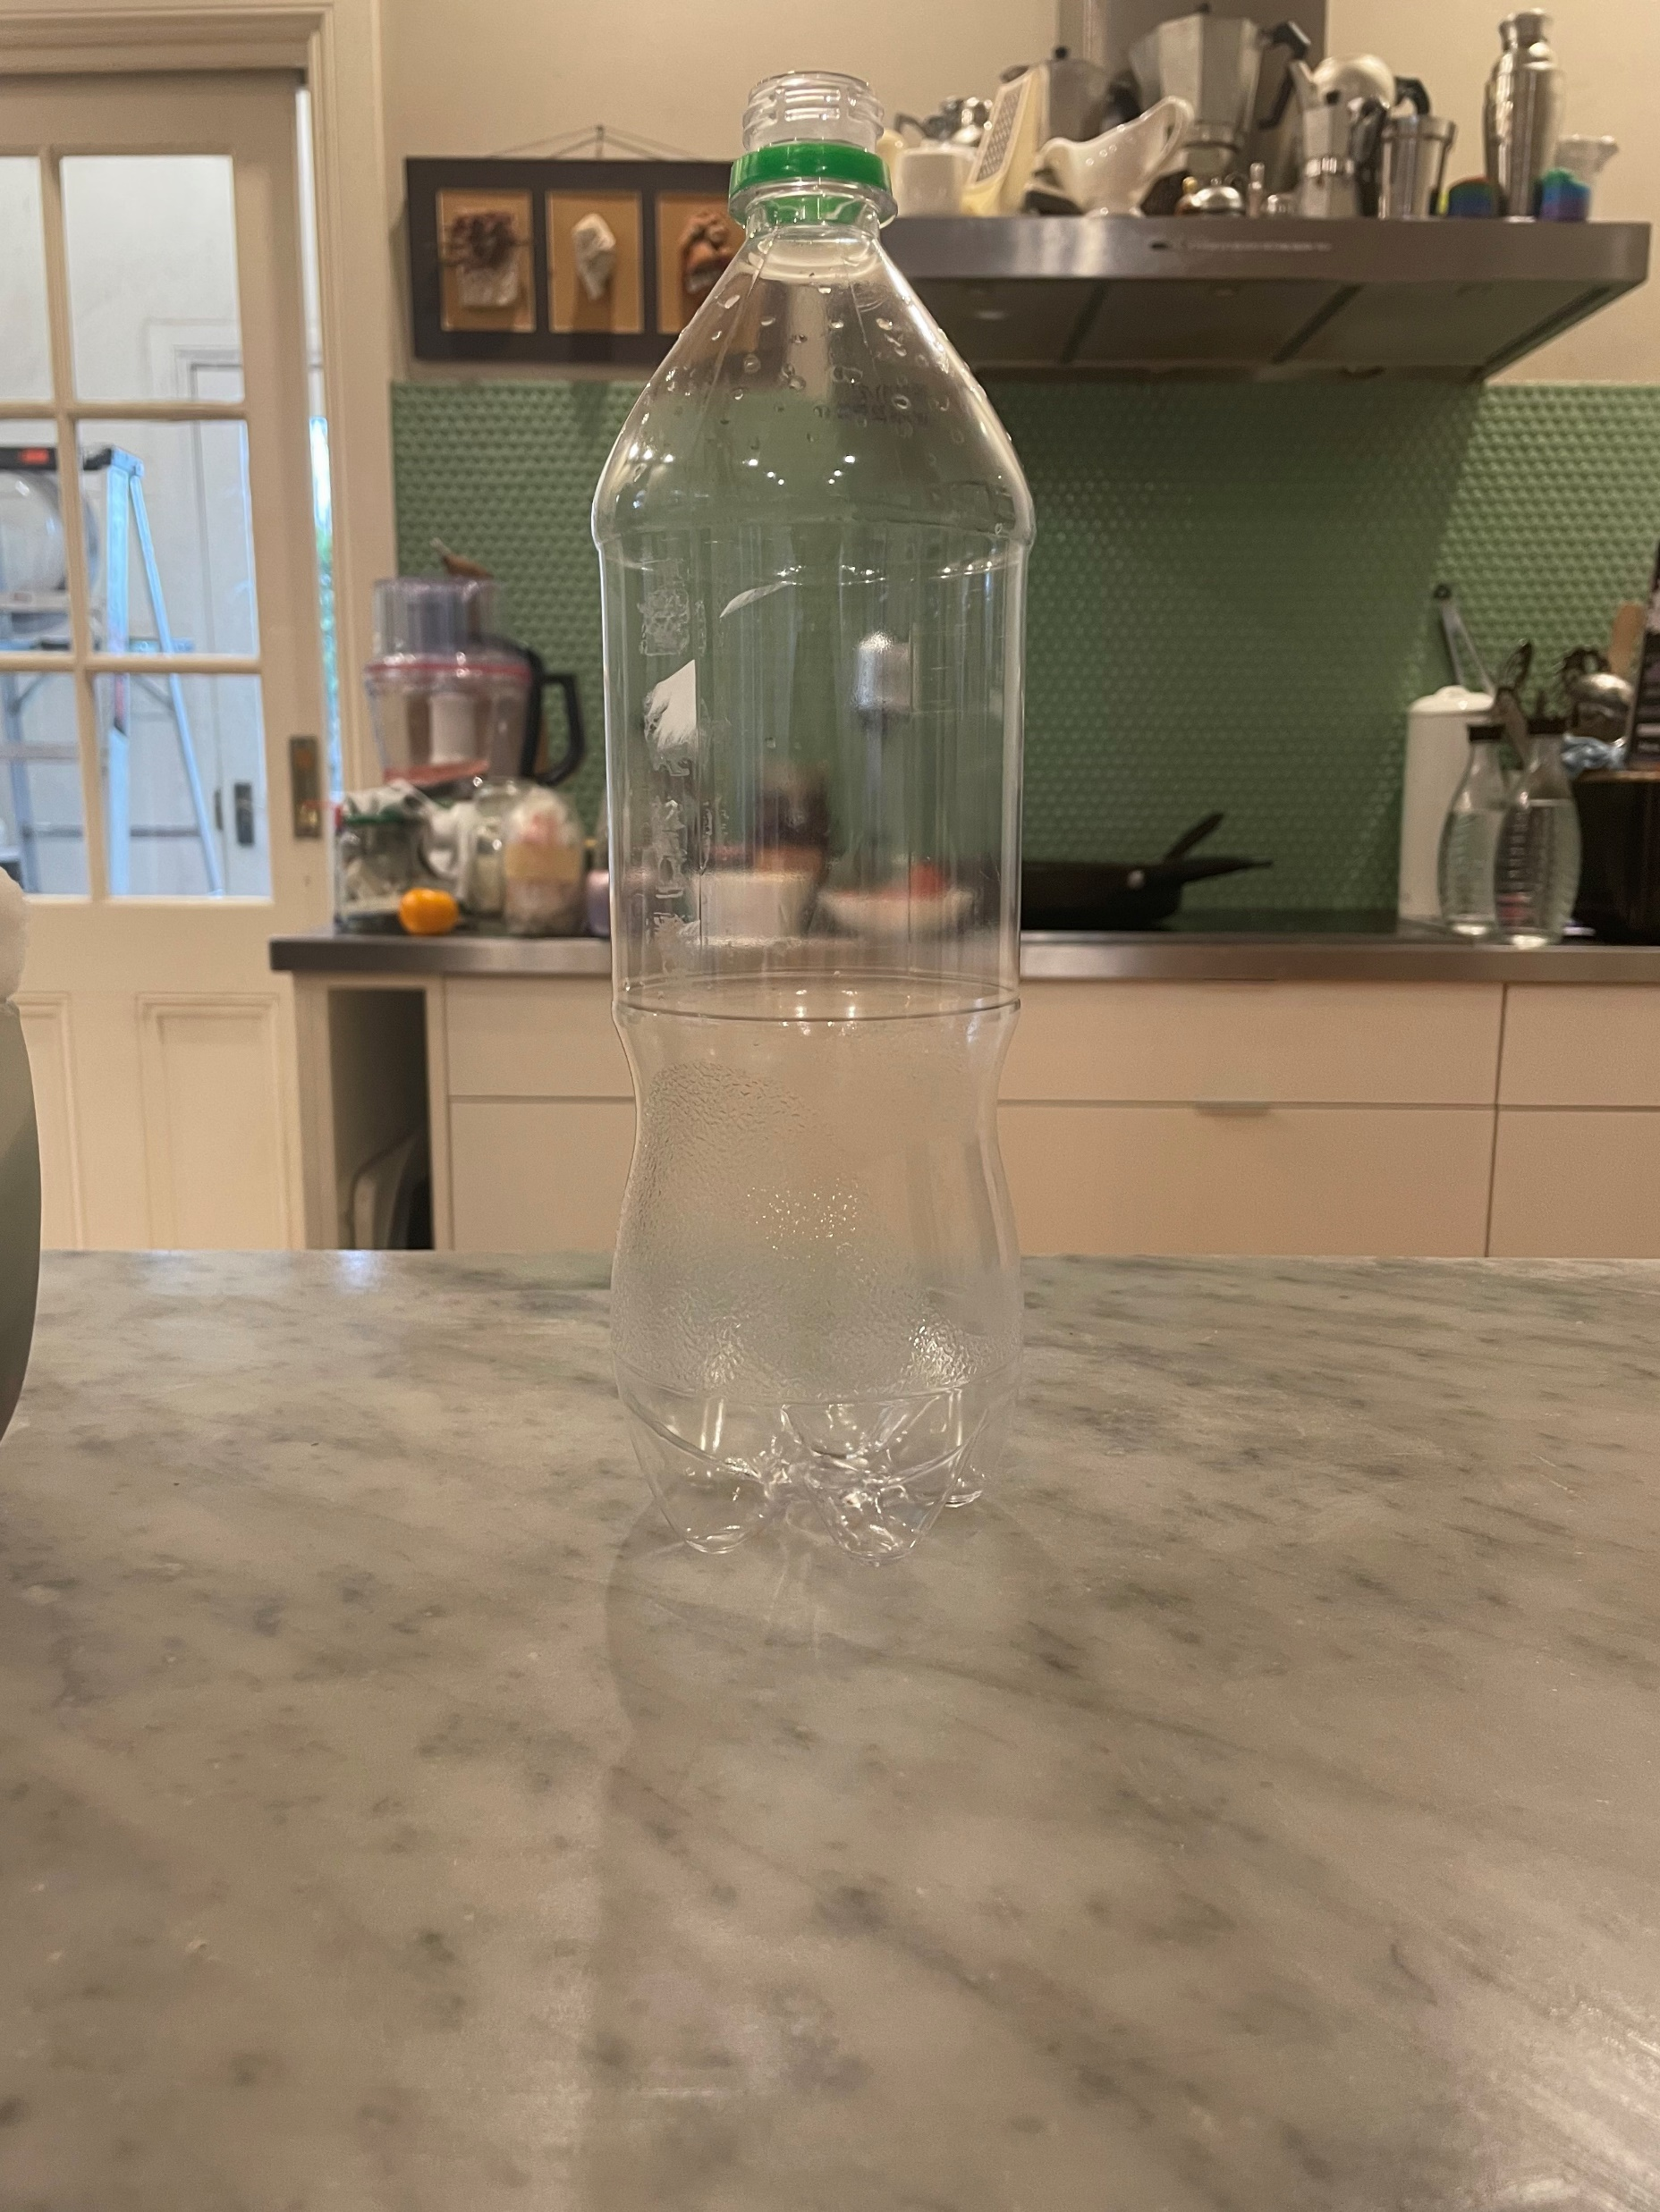
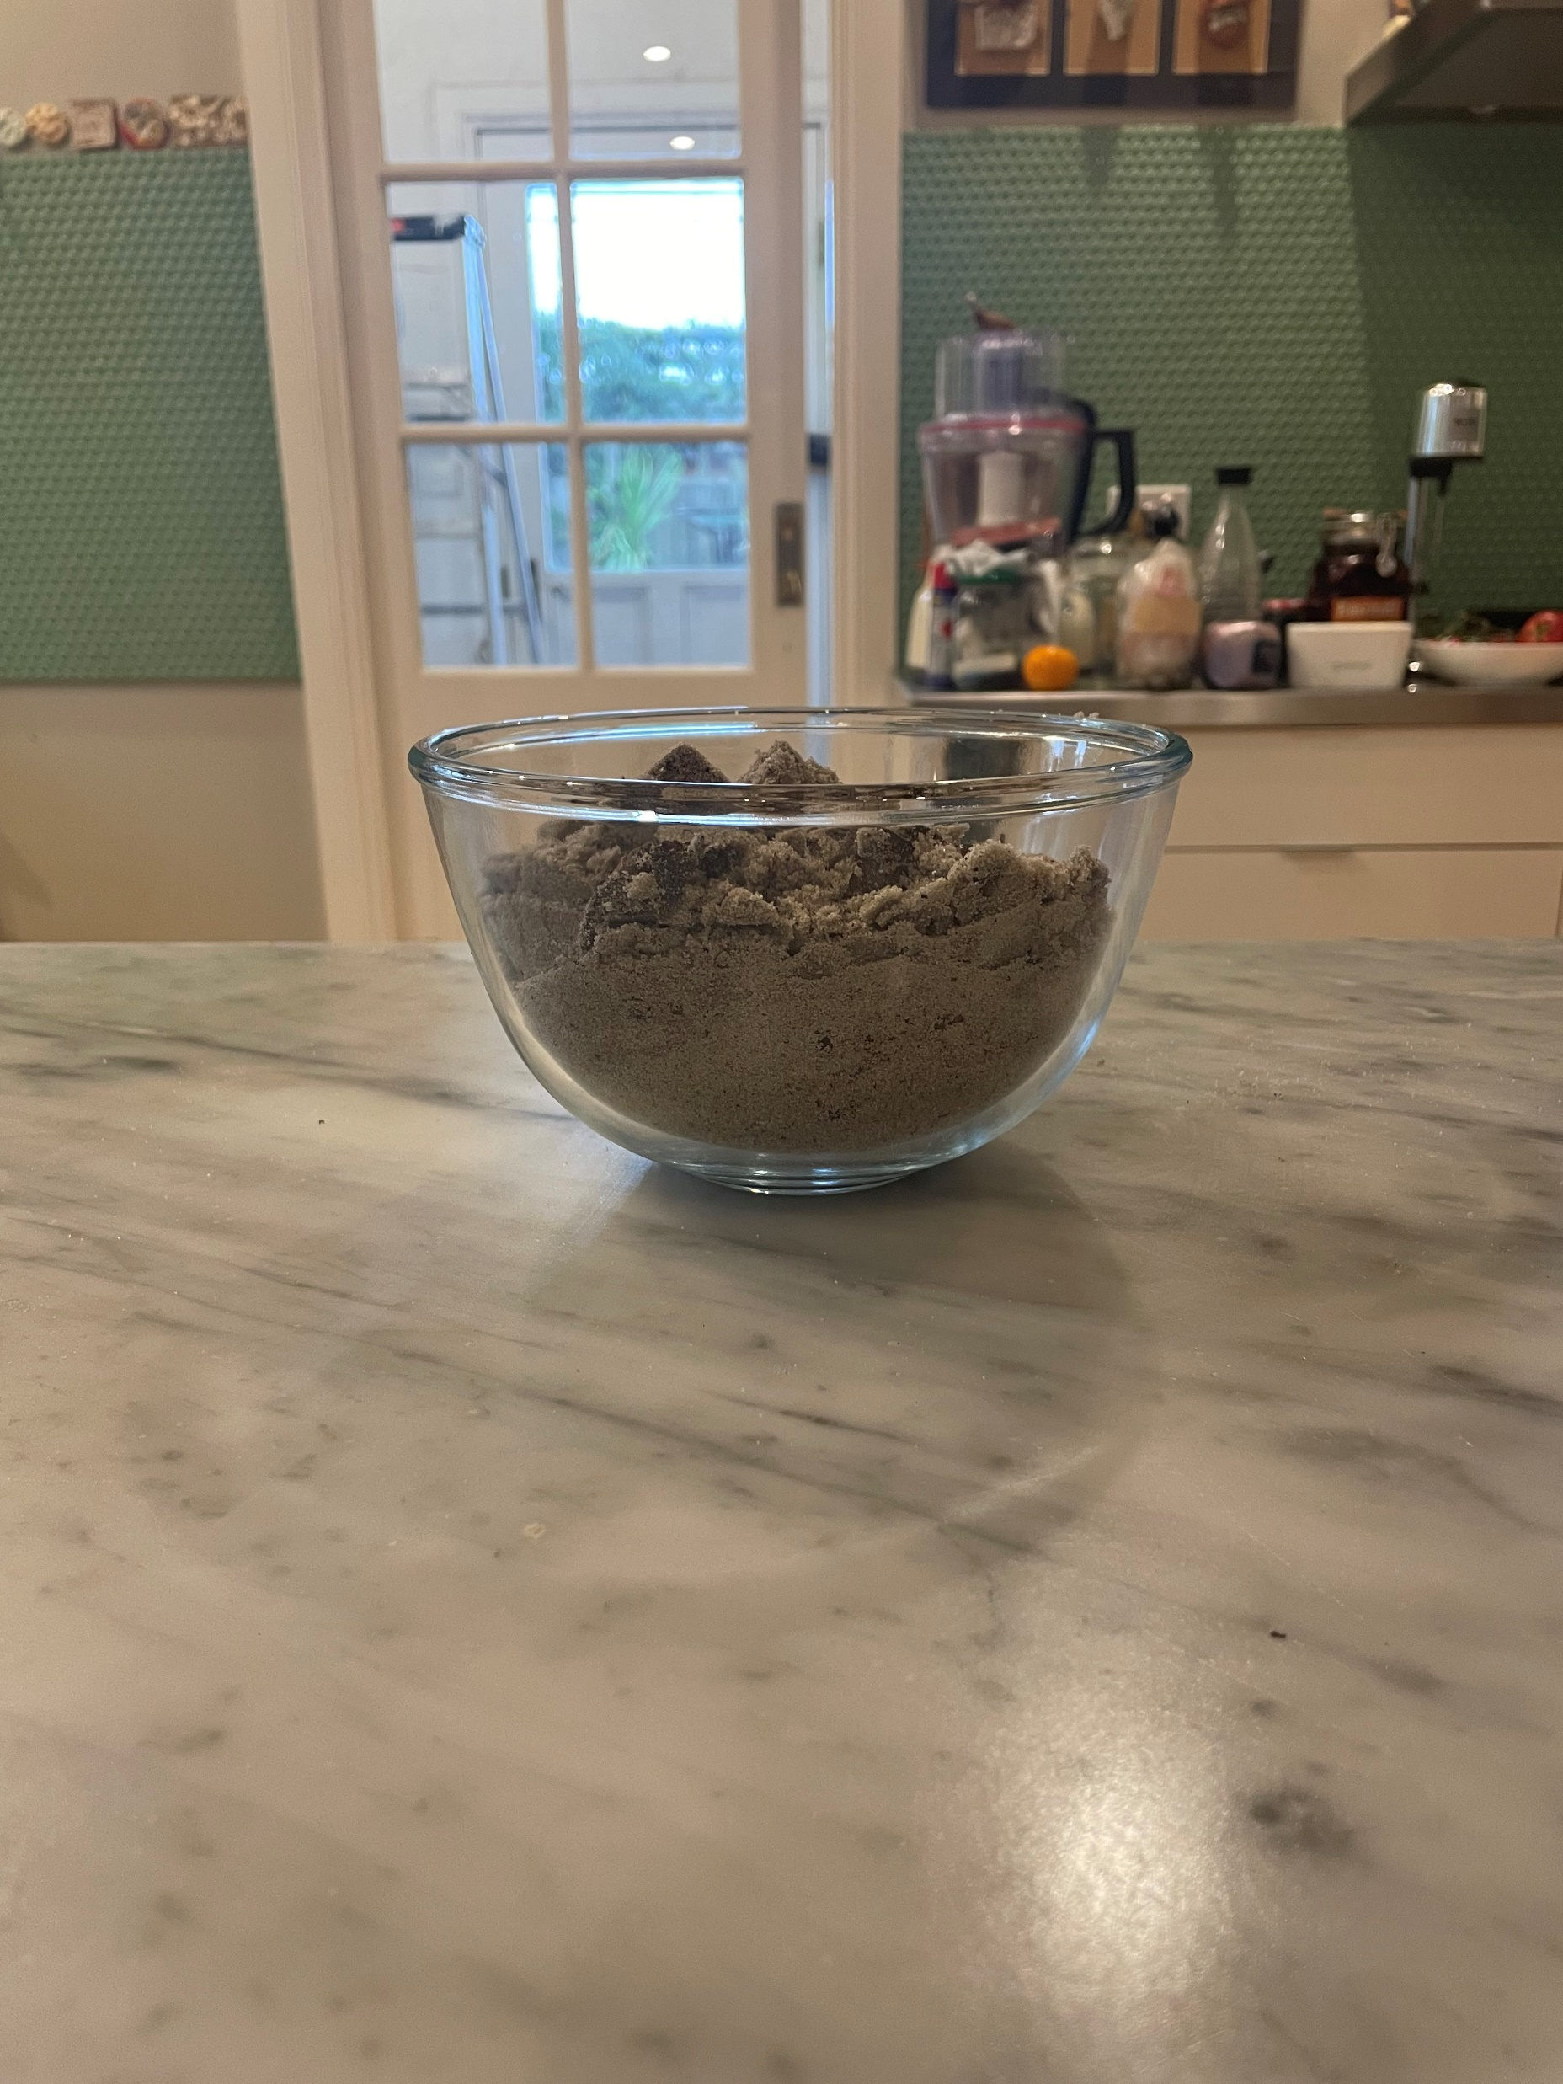
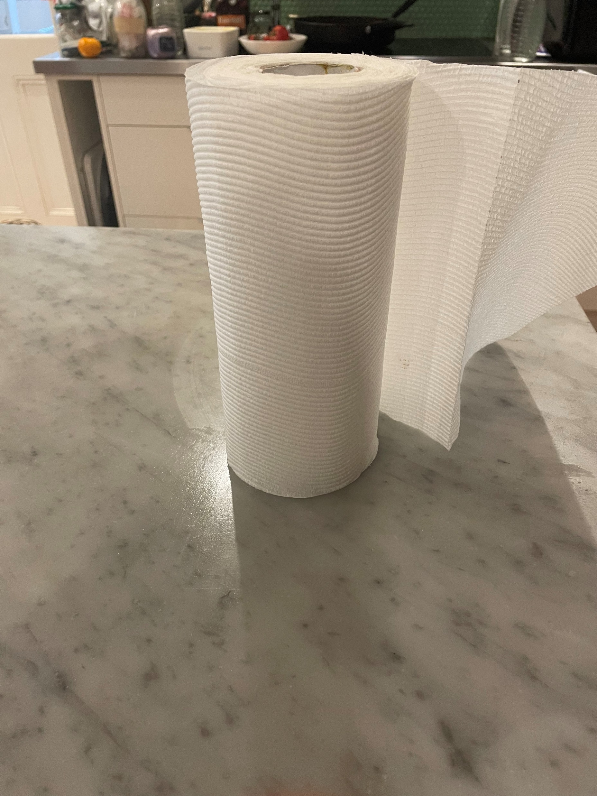
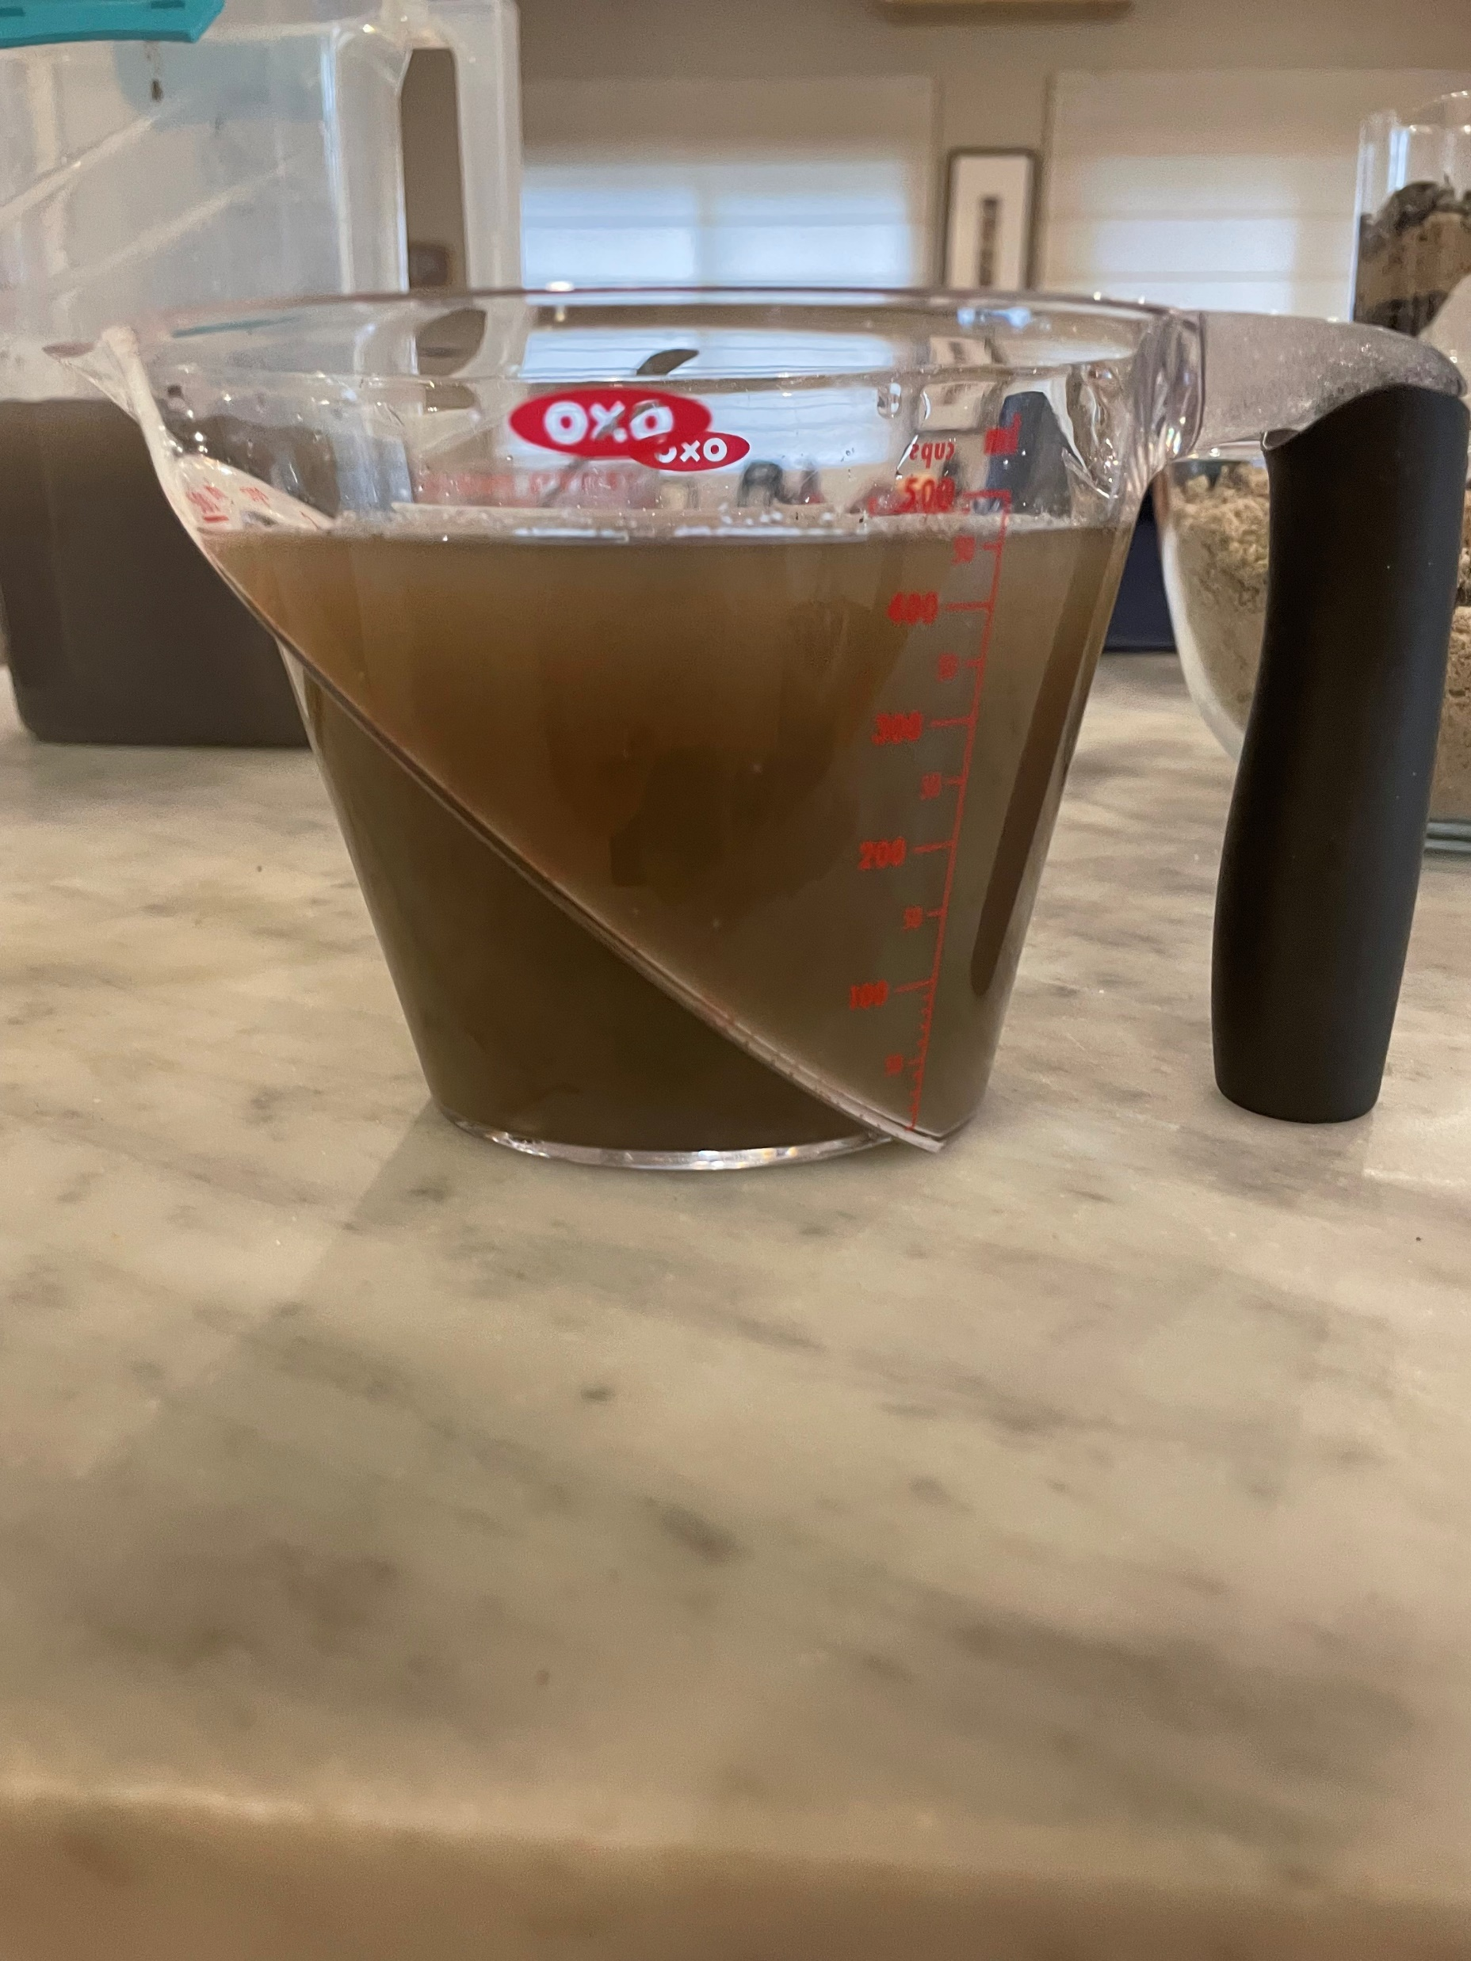
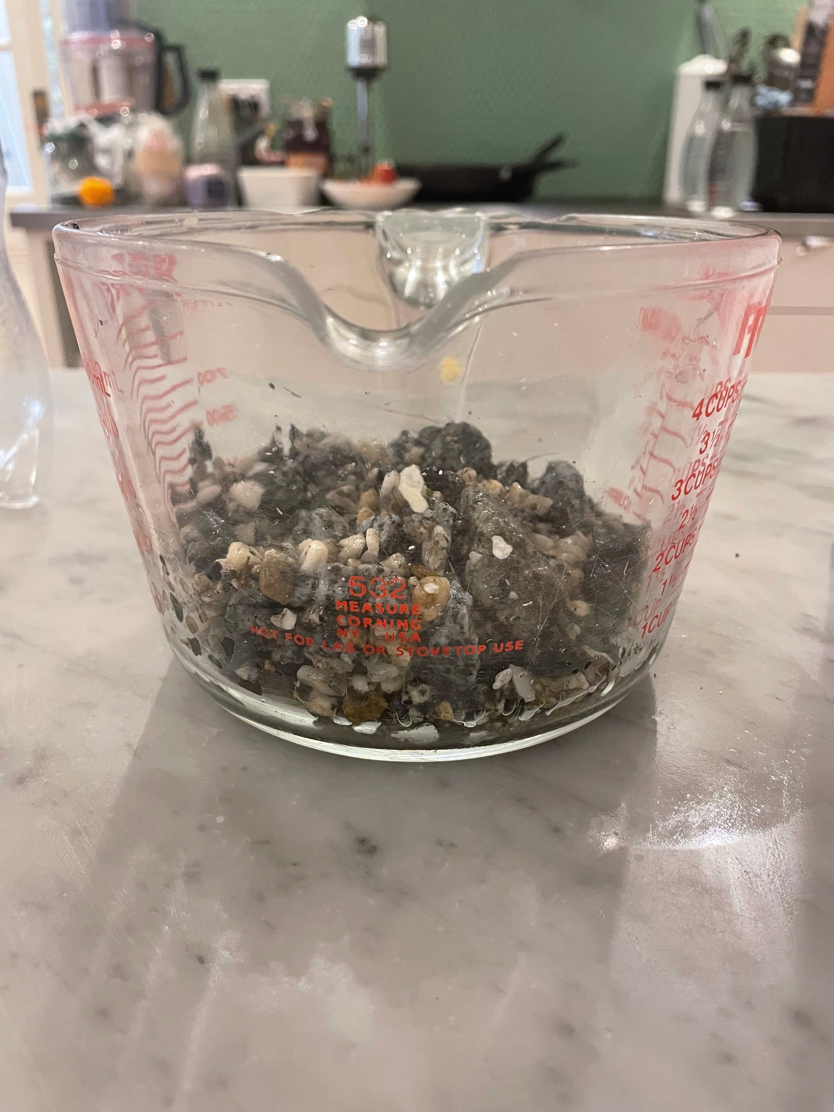
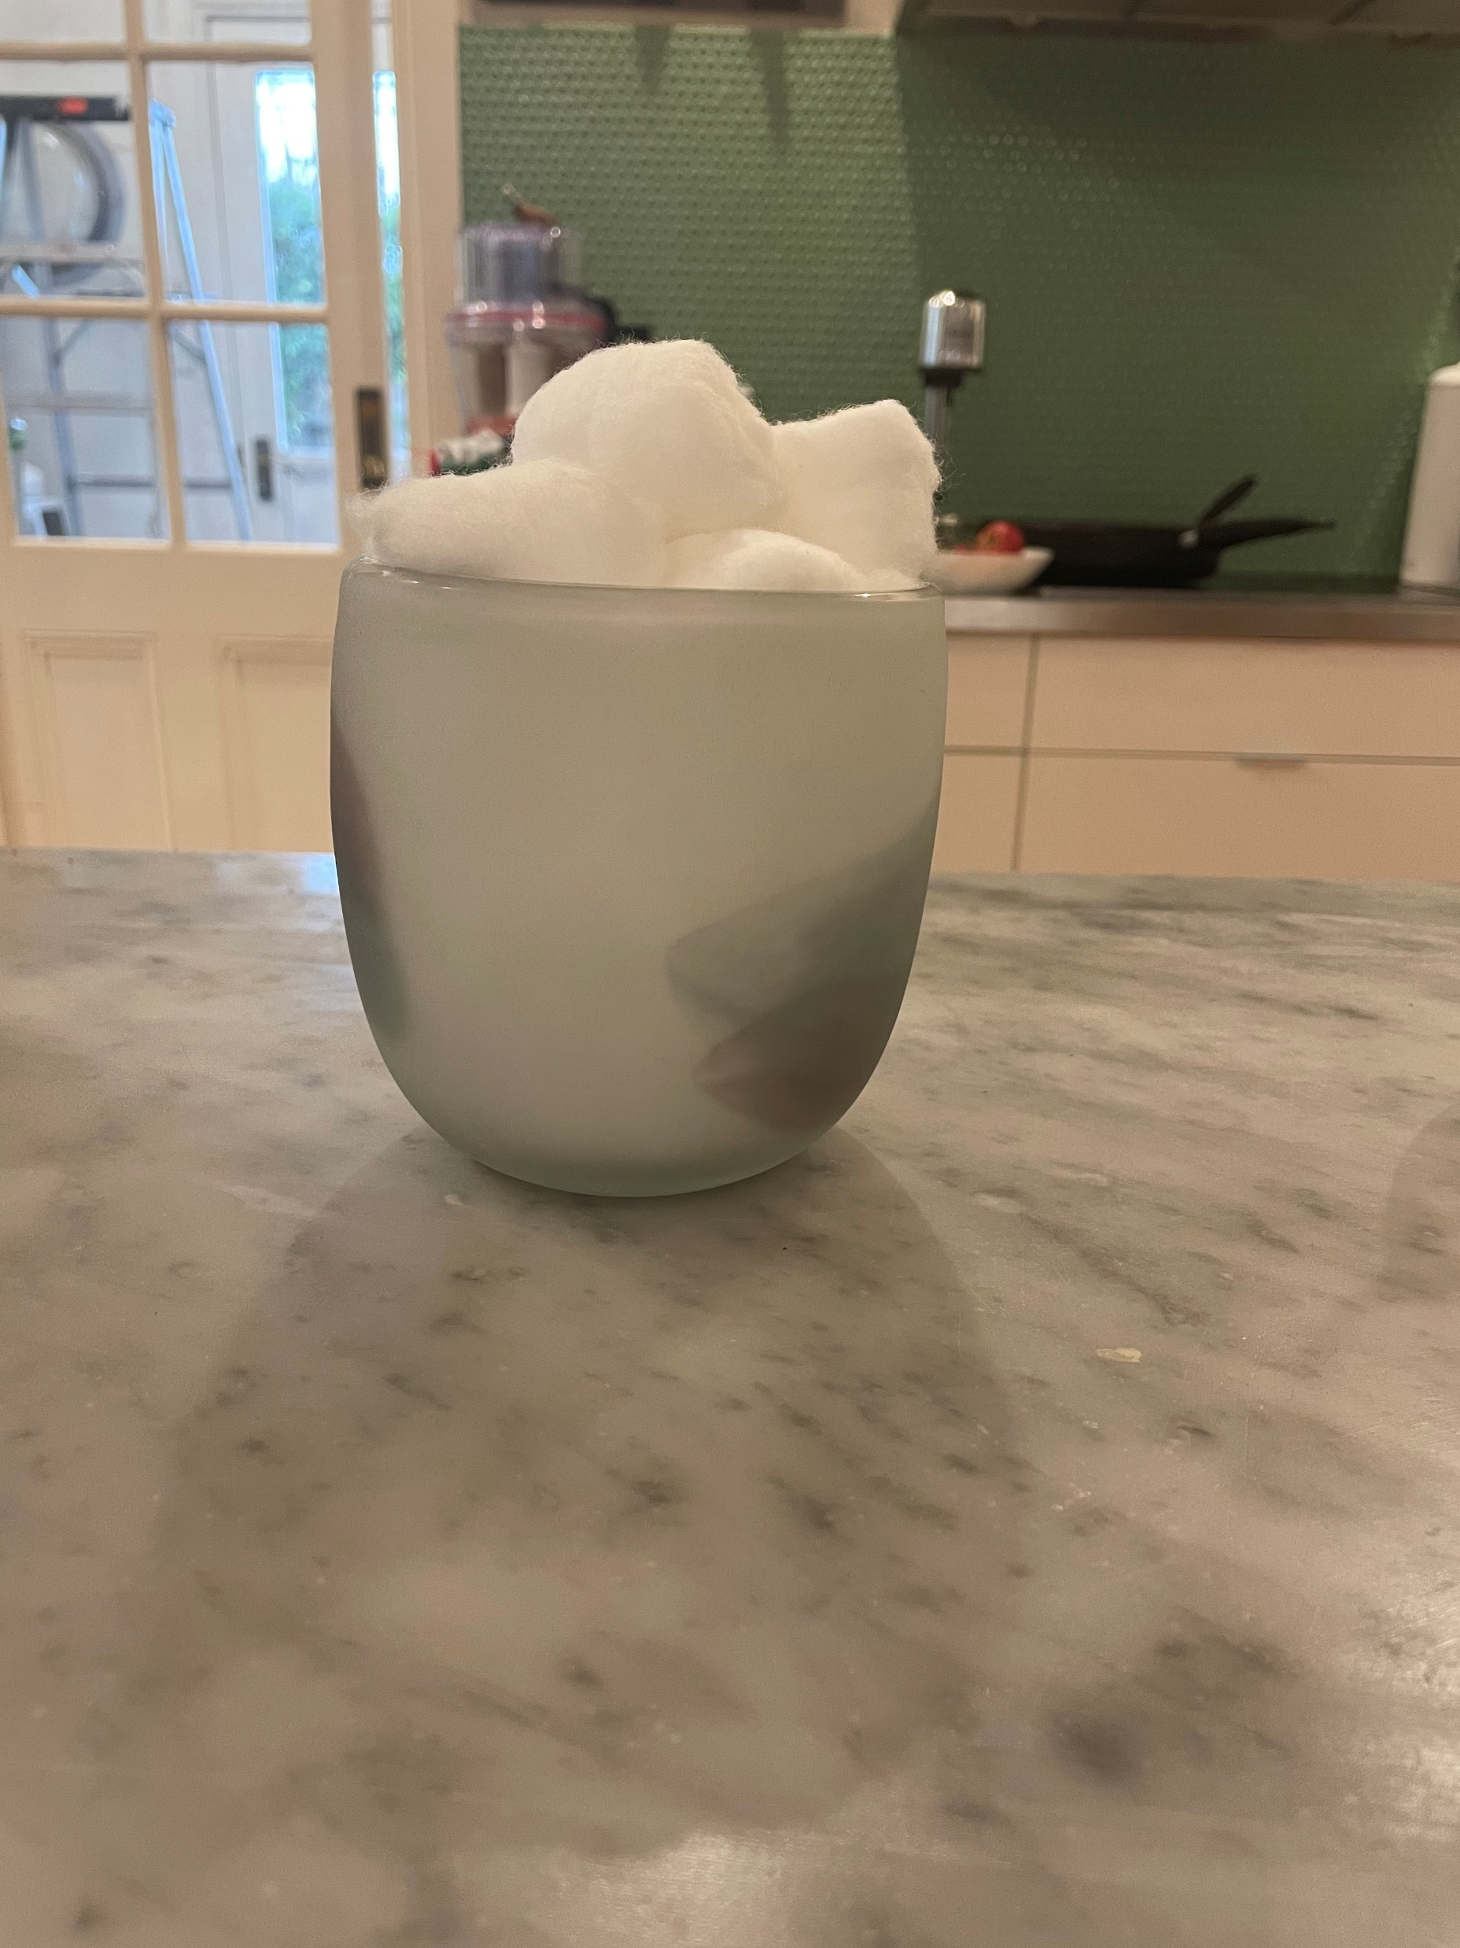
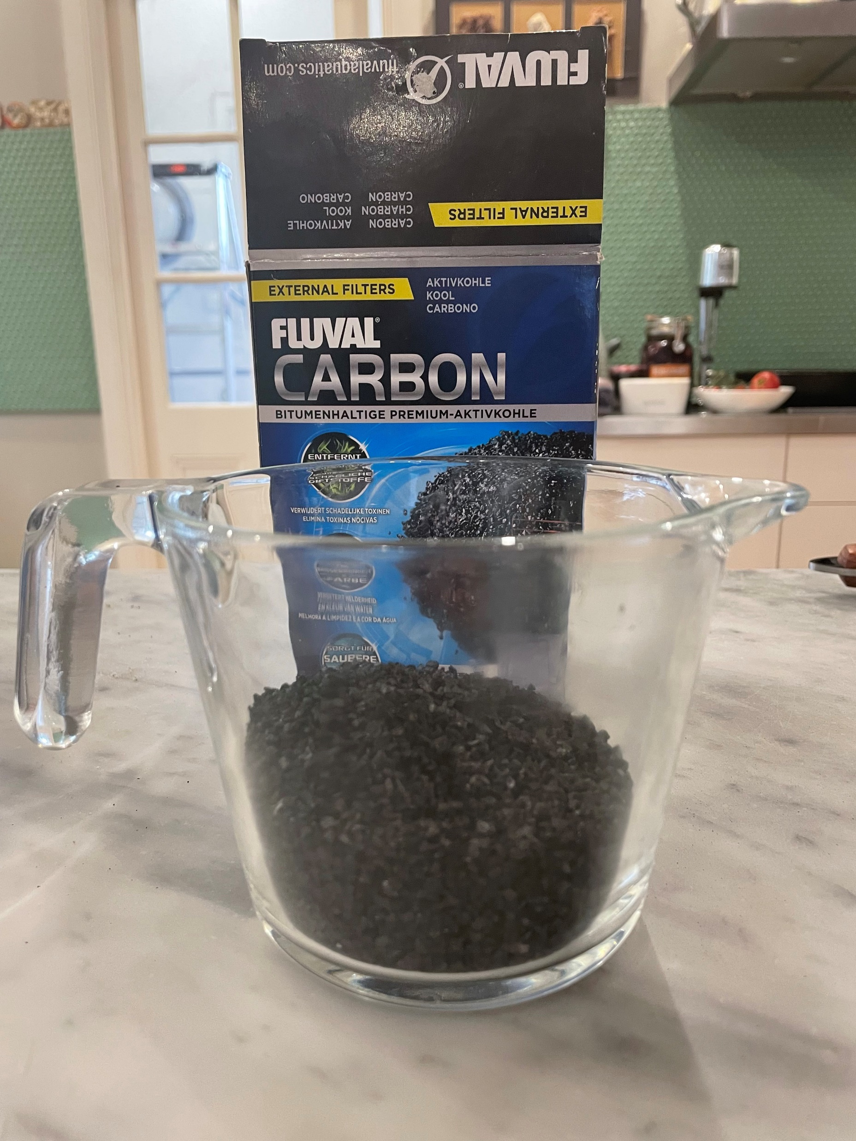
The Materials Used
An empty soda water bottle that was recycled acted as the foundation of the filtration system.
The sand was the 4th layer of my filtration system. It was like the carbon, as it had fine holes for liquid to travel through. It was taken from a local playground.
All of the materials used in this experiment were either recycled or were everyday items that came in handy.
Some paper towels from the kitchen acted as filter paper in my filtration system, it was the first layer.
Gravel was a very useful filter, as the rocks easily stopped any large solids, while giving an easy flowing pathway for water. It was the 5th layer. It was found on the pavement.
Cotton wool balls act as a secondary filter paper, blocking final pieces of dirt and gravel. Taken from bathroom
Activated charcoal, (carbon) was another material that collected the rubble in the water, and was recycled from an old fish tank. It was the 3rd layer.
The final material, is obviously, dirty water, it was the remains of rinsing the gravel, and is used to initiate the experiment.

Slide 4
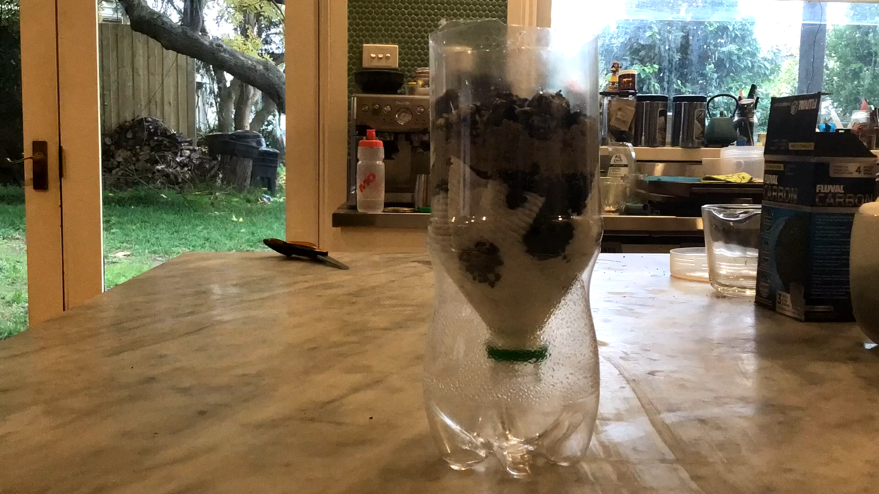
The process
I started by making the filtration system. I cut my empty bottle in half horizontally and then stuffed my filter paper into the bottom of the bottle. I continued by stuffing 4 cotton wool balls into the bottle and then poured my activated charcoal, (carbon) into the bottle for my 3rd layer. I then poured in my sand, followed by my gravel.
Then I poured my 500mL of dirty water into the bottle to start the process. The gravel, at the top layer, removed the larger grime and dirt from the water. Each material was finer and finer as the water flowed down; so the smaller impurities were removed in each layer. I then redid the process to remove any last bits of grime there was, until my time was up.

Slide 5
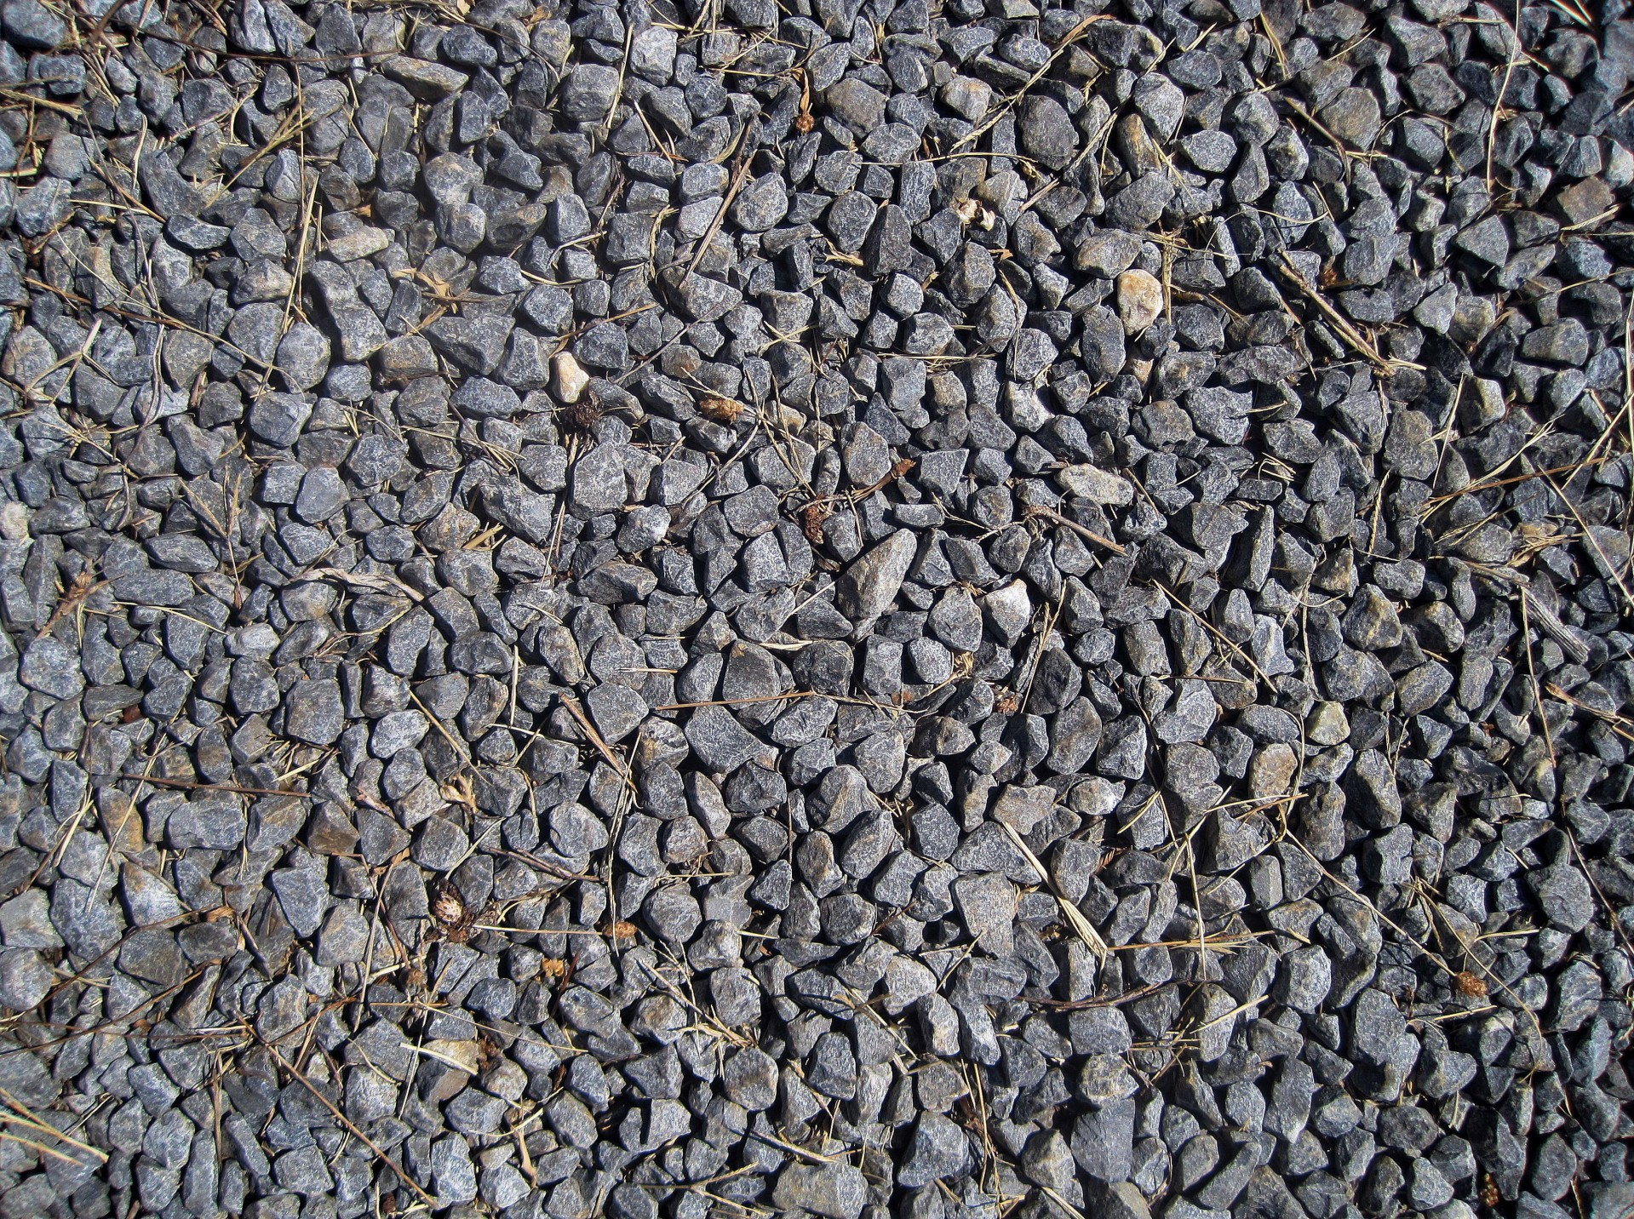
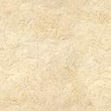
The Challenges Faced
Drawing Of My Filter
Gravel.
Sand.
The main challenge I faced during this project was organising all of the materials and getting it done while I could.
The only other thing that I found hard was time management, as I had multiple CATs that I was working on, and I missed multiple sessions.
Filter paper.
Activated Charcoal, (carbon)
Cotton wool balls.
Recycled bottle.

Slide 6
Task 2
Advertising Campaign

Slide 7
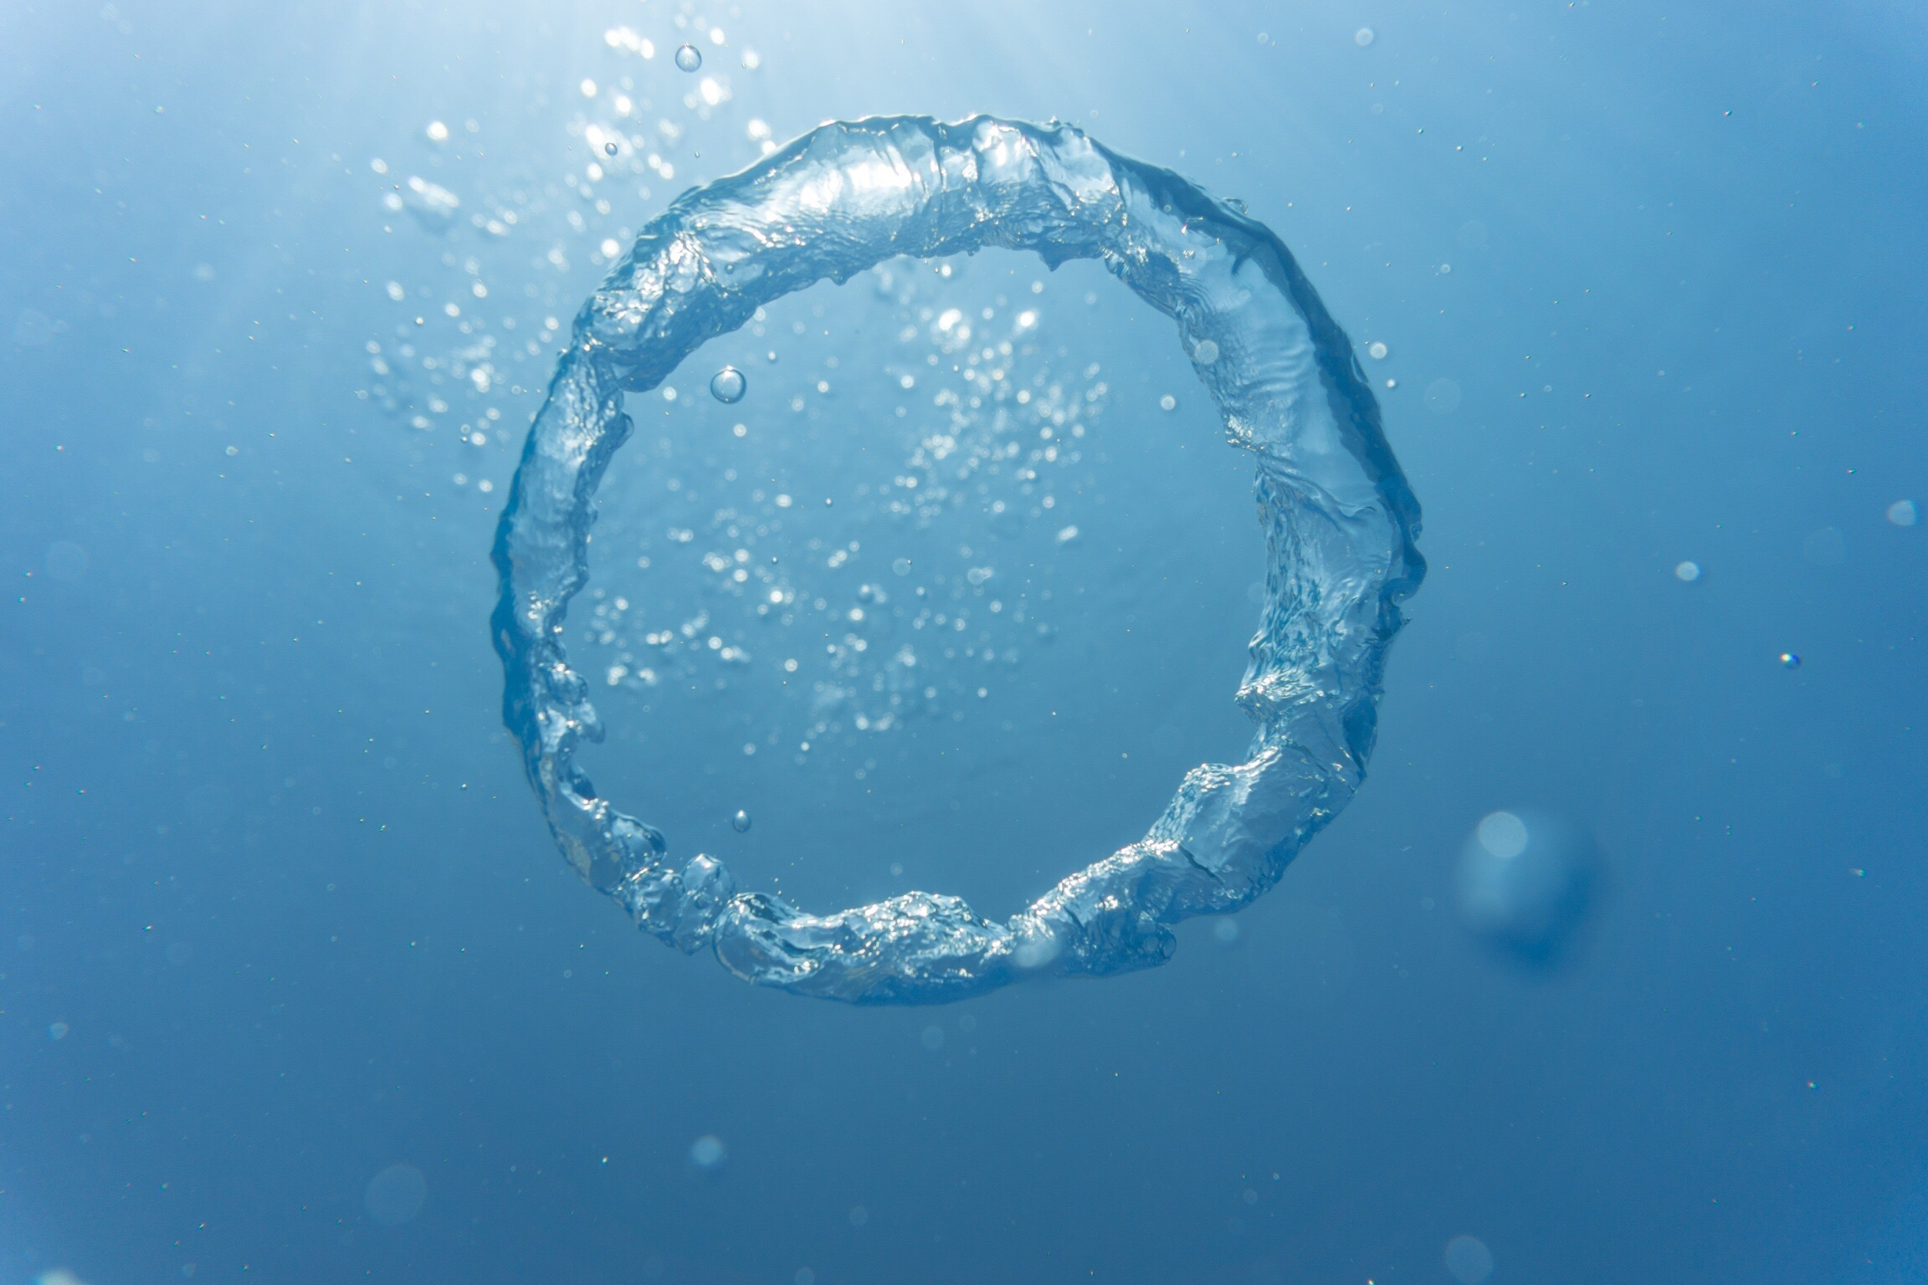
Logo
WAY
OF
THE
WATER

Slide 8
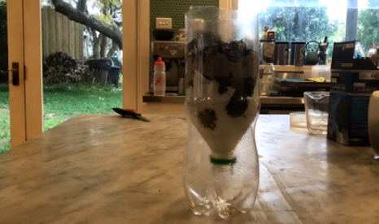
Advertising Campaign
At The Way Of The Water, we provide clean and safely produced water recycled from the water that Melbourne uses. Every time you wash something down your sink, run a bath or use any house appliances that include water, it all comes to us. We filter the water using an in-depth system where we wash out all bad grime and dirt, by putting it through different materials that let the water wash through but stop all the bad germs from getting into your water. Studies have shown that bottled water is no better at hydrating you than tap water, and it’s healthier. During blind taste tests, nobody was able to tell the difference.
My Filtration System

Slide 9
Task 3
Research Questions

Slide 10
Different Ways To Separate Mixtures
Chromatography
Chromatography is a way of separating mixtures in which you take a solvent, (water that has a solute dissolved into it,) and pass it through filter paper to cause the molecules to separate into layers.
Distillation
To distillate a solvent, you must heat it to boiling point, once it has evaporated you must contain the vapour. After the has cooled down it will condense to create a distillate, a crystalized version of your initial solute.
Decanting
Decanting is a separating method that you use on heterogeneous mixtures in which you pour the mixture slowly in order to remove the sediment from the mixture.

Slide 11
How I Feel About Recycled Water
I believe that (in Australia) tap water is perfectly safe to drink. You can see in this study* that you are better off filling your cup at home; it has been shown that tap water is much more stringently tested than bottled water and that it is much healthier because of it. Tap water is just as hydrating as bottled water and in blind taste tests, volunteers were unable to tell the difference between them.
Bottled water is overpriced and is statistically, 2000x more expensive than tap water, all for a beverage that is of less quality.
*https://startsat60.com/media/news/tap-water-vs-bottled-water-study-reveals-which-is-better-for-you#:~:text=Tap%20water%20in%20Australia%20is,vary%20depending%20on%20the%20brand.

Slide 12
What Is A Desalination Plant
A desalination plant is an industrial facility in which they separate drinking water from seawater.
They use a variety of purifying techniques to clean the water, and they start by funnelling the seawater into the desalination plant through an intake system. After a simple filtration, the water is forced through microscopic membranes at high pressure. These membranes allow the water particles through but block any other unwanted particles.
They then use flocculation to remove any last chemicals, and after that, the water is completely fresh and drinkable.

